Slide 1
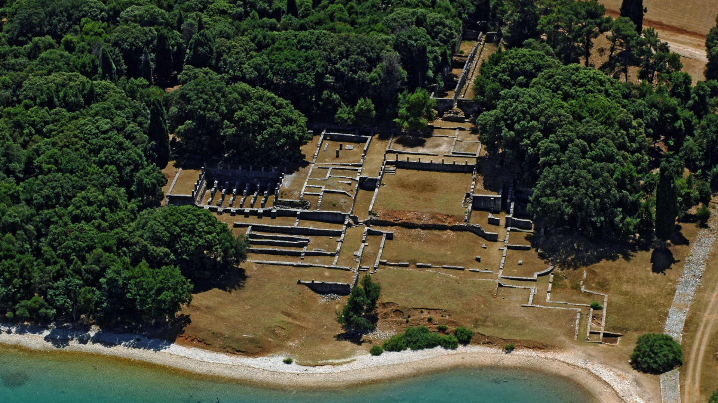
Nacionalni park Brijuni
Vaši vodiči:
Mihovil Parčina
Đurđica Kovačić
https://www.np-brijuni.hr/imagecache/maxsize/6f67e492-4a50-4136-93fd-89f06287a549/29-12-2018/verige_vila_3.jpg

Slide 2
Put je planiran u V. mjesec
9:00 sati | Polazak brodom iz Fažane za Brijune
9:00-9:15 sati | Tumačenje kratke povijesti i geografije Brijuna za vrijeme vožnje
9:15-13:15 sati | Vlakom obilazak uvale Verige i rimske vile rusticae iz I. st.n.e., safari i dino parka; Obilazak male gotička crkva Sv. Germana iz 15. st., šetnja do stare masline, bare i Mediteranskog vrta
13:15-14:15 sati | Ručak u restoranu „Galija”
14:15-15:30 sati | Šetnja poučnom stazom Zelenikovac
15:30-15:45 sati | Pauza i mogućnost kupovine suvenira te šetnja do luke
16:00 sati | Povratak brodom u Fažanu
Cjenik:
1 pojedinačna karta (14+) 230 kn
Grupe (najmanje 25 osoba) 170 kn
+ ručak po želji

Slide 3
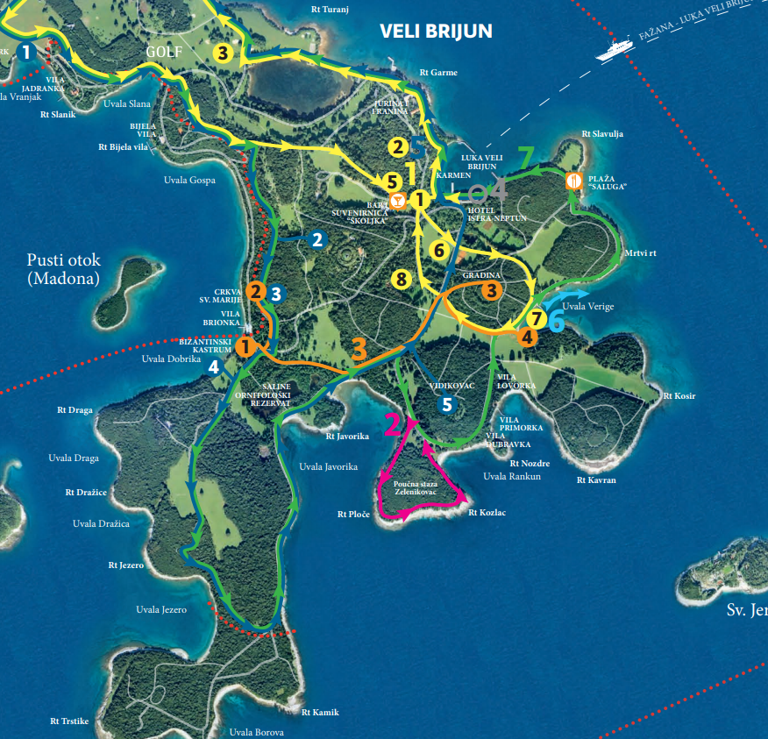
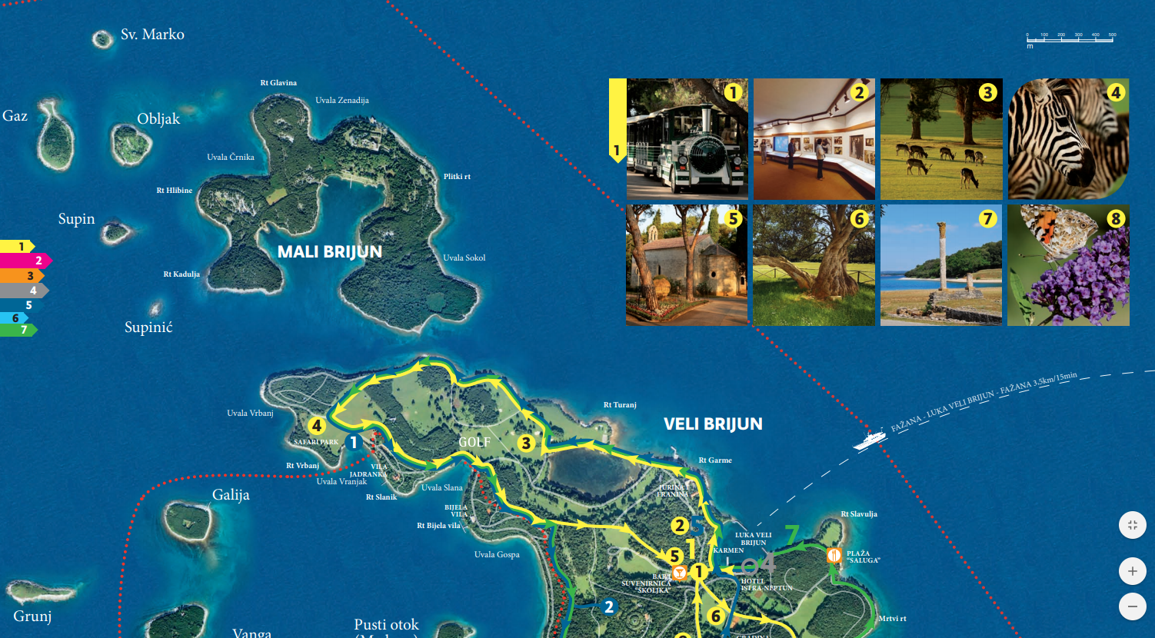
https://www.np-brijuni.hr/download/6f67e492-4a50-4136-93fd-89f06287a549/28-02-2019/brijuni_kartaizleti2016_web.pdf

Slide 4
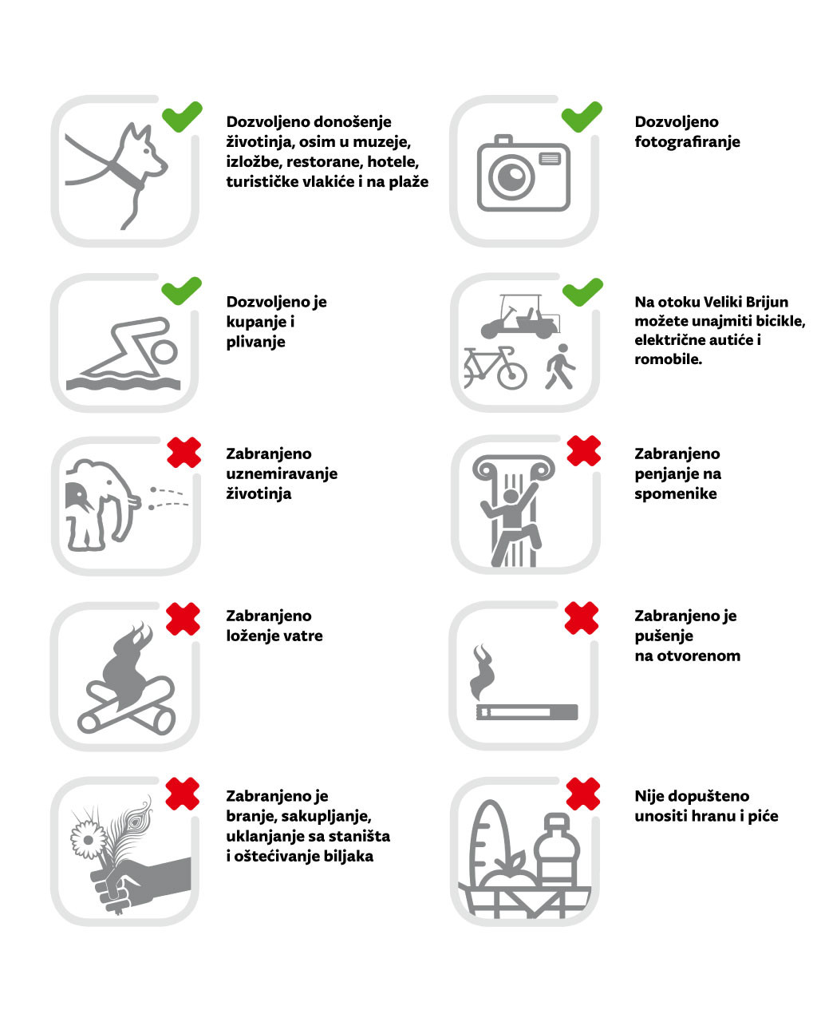

Slide 5
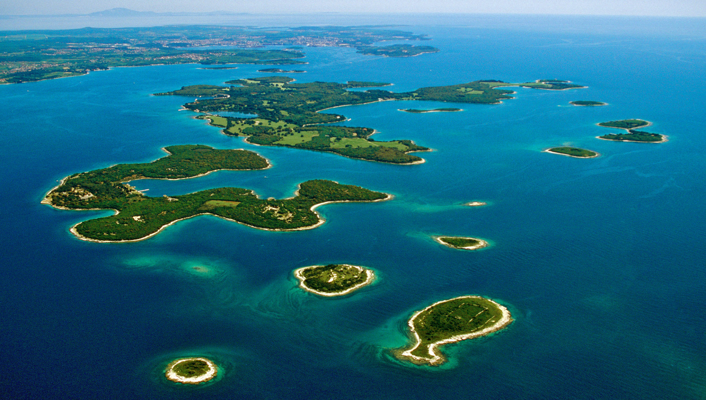
površina 33.9 km²
južni dio zapadne obale Istre
utemeljen 27. listopada 1983.
https://www.np-brijuni.hr/en/brijuni/the-brijuni-archipelago/other-islands
skupina od 14 otoka (najveći – Veliki Brijun)
najrazvedenija i najveća skupina otoka istarskog područja
do prije deset tisuća godina su bili sastavni dio istarskog kopna
https://www.np-brijuni.hr/imagecache/large/6f67e492-4a50-4136-93fd-89f06287a549/28-02-2019/brav0133.jpg

Slide 6
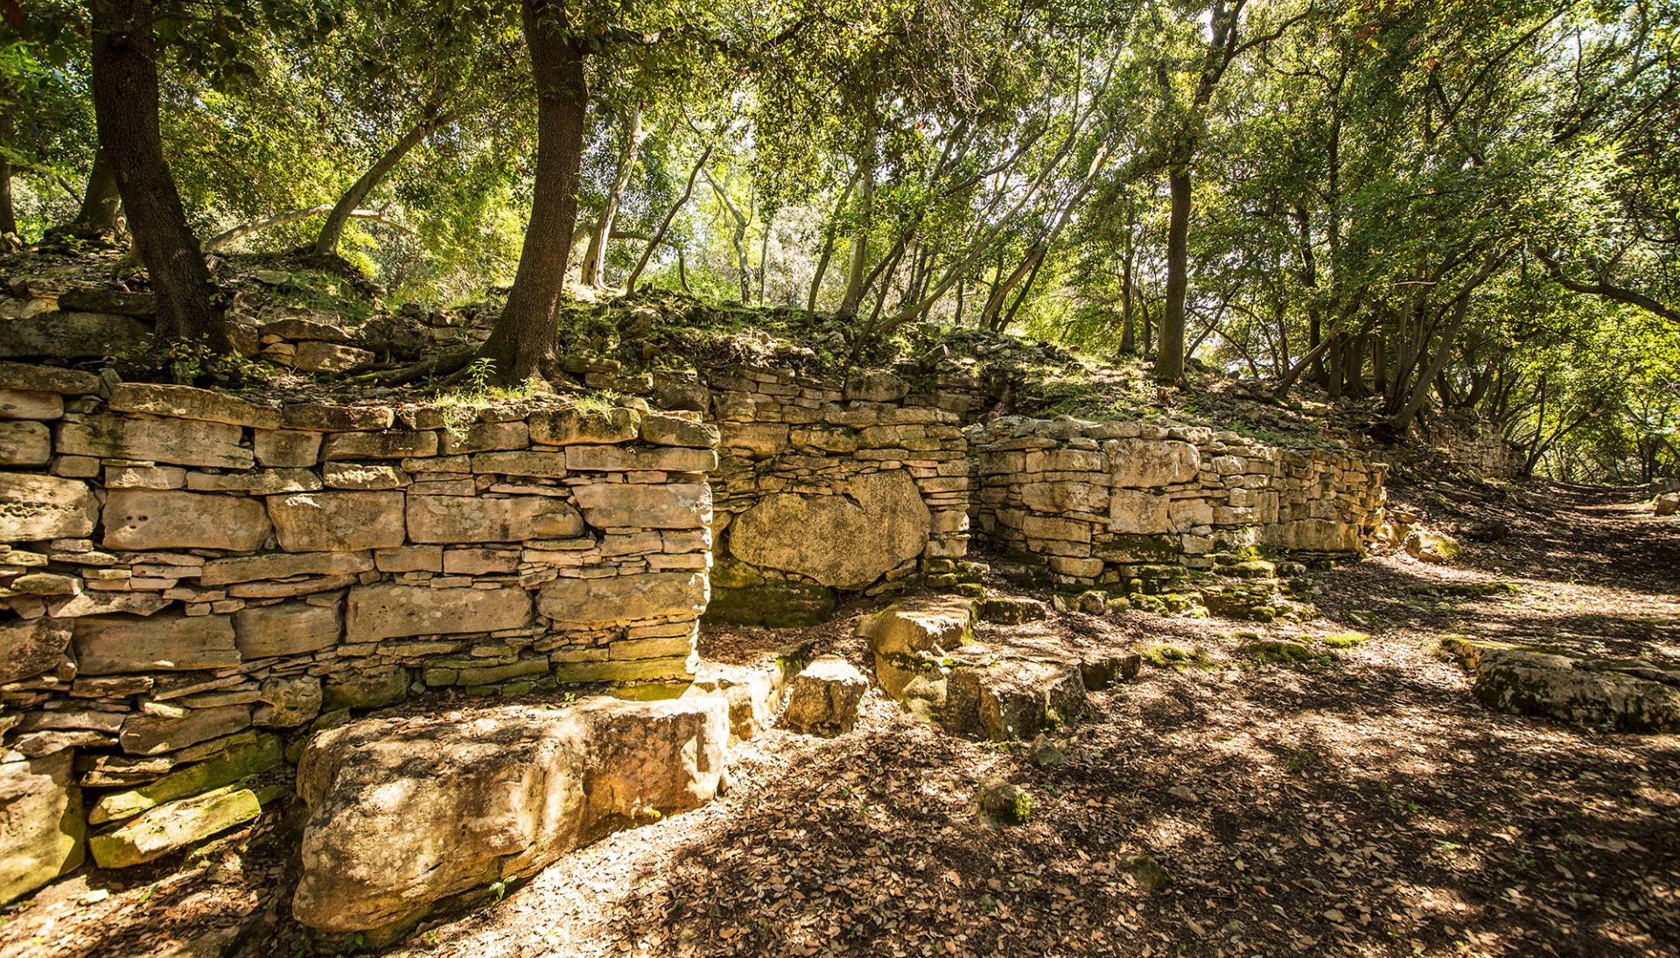
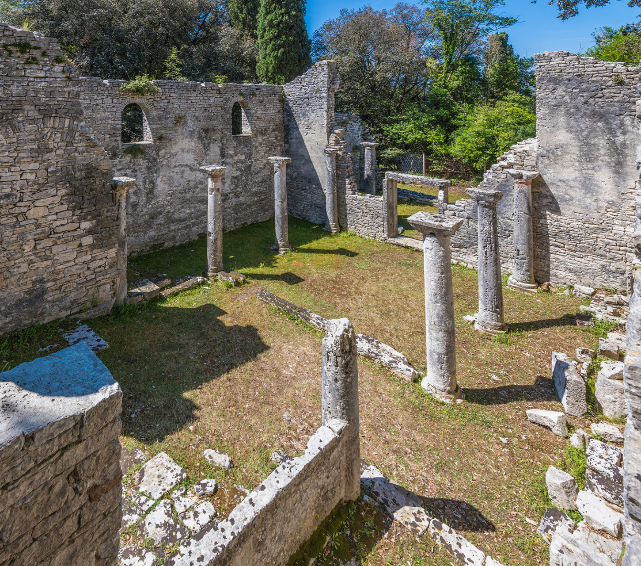
https://www.np-brijuni.hr/imagecache/maxsize/6f67e492-4a50-4136-93fd-89f06287a549/29-12-2018/crkva_sv_marije_brijuni_3.jpg
https://www.np-brijuni.hr/imagecache/maxsize/6f67e492-4a50-4136-93fd-89f06287a549/06-03-2019/gradina_1.jpg

Slide 7
https://www.google.com/url?sa=i&url=https%3A%2F%2Fchew-chewtrain.com%2Fhome%2Ftrain-3%2F&psig=AOvVaw1k1W33el13EcSR9Dg7y4Ga&ust=1592085273590000&source=images&cd=vfe&ved=0CAIQjRxqFwoTCMjCv_uh_ekCFQAAAAAdAAAAABAJ

Slide 8
https://www.np-brijuni.hr/imagecache/maxsize/6f67e492-4a50-4136-93fd-89f06287a549/29-12-2018/verige_vila_2.jpg

Slide 9
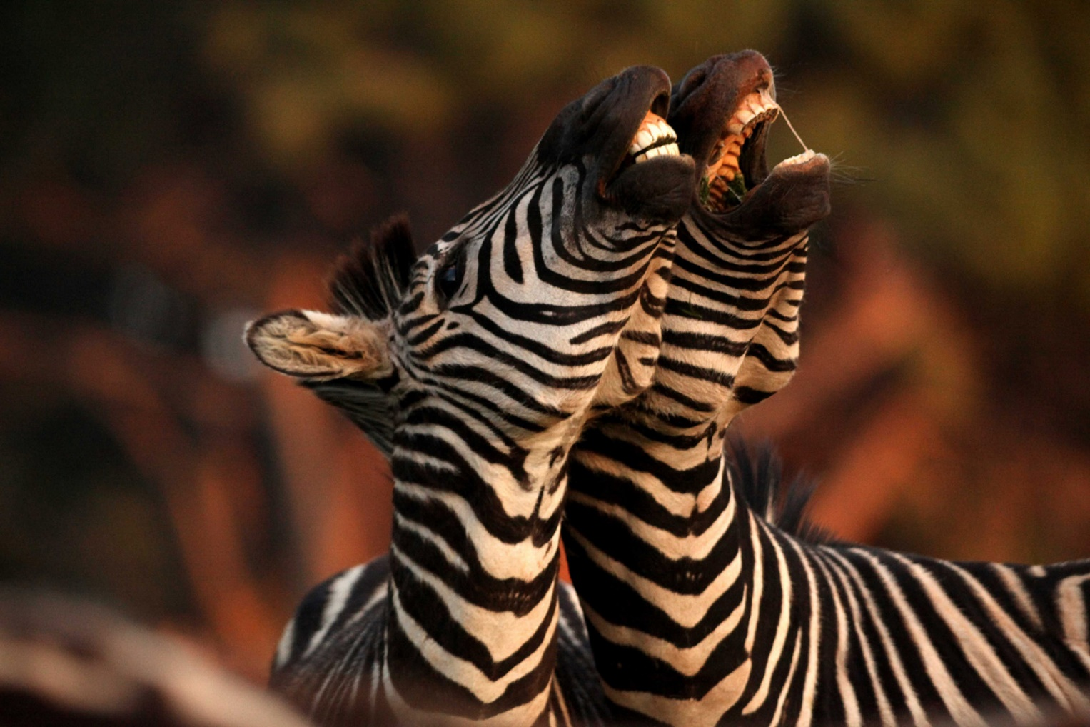
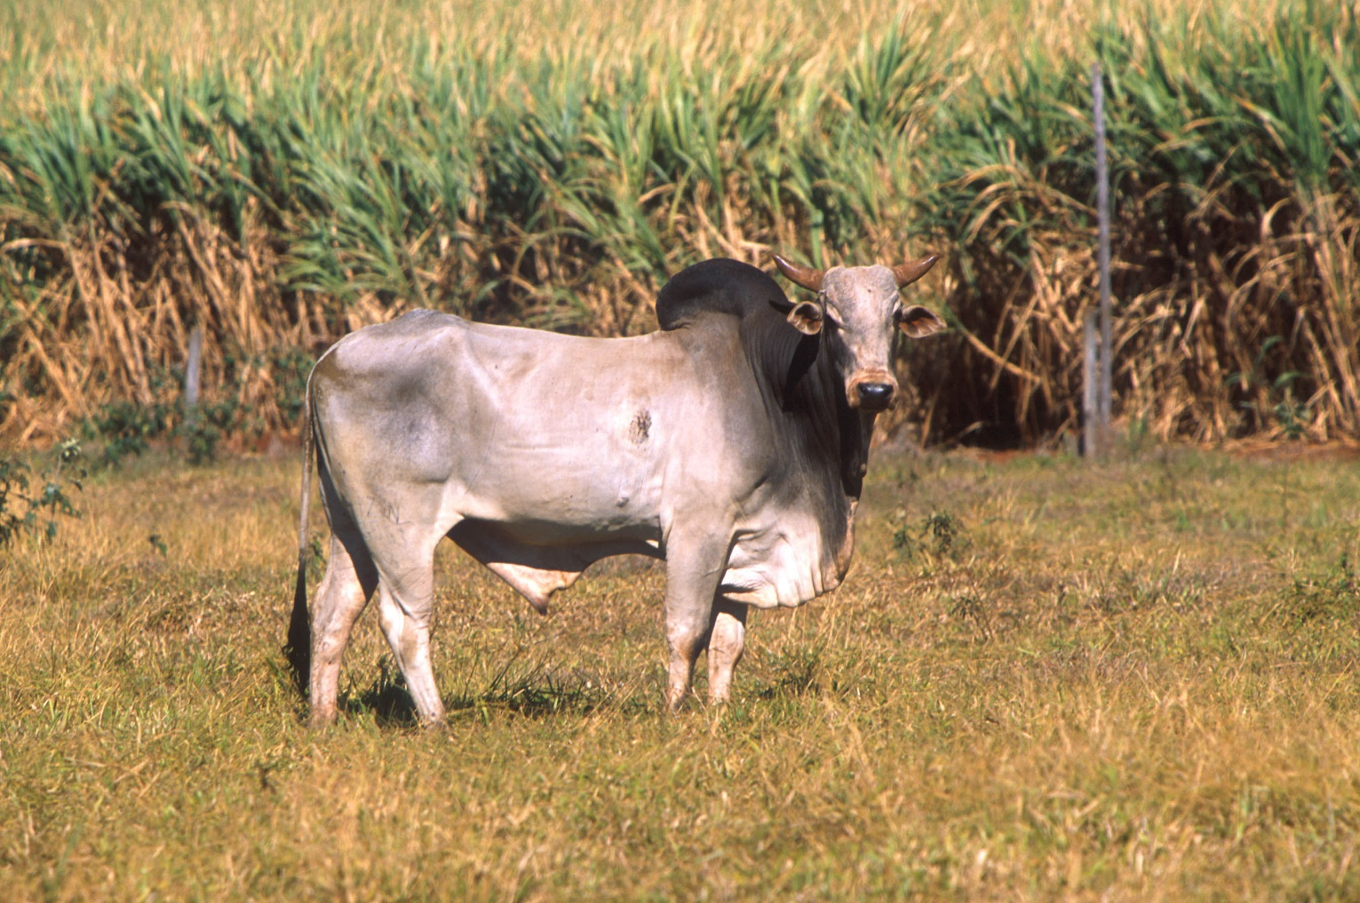
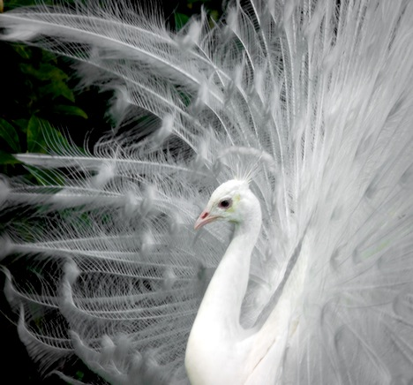
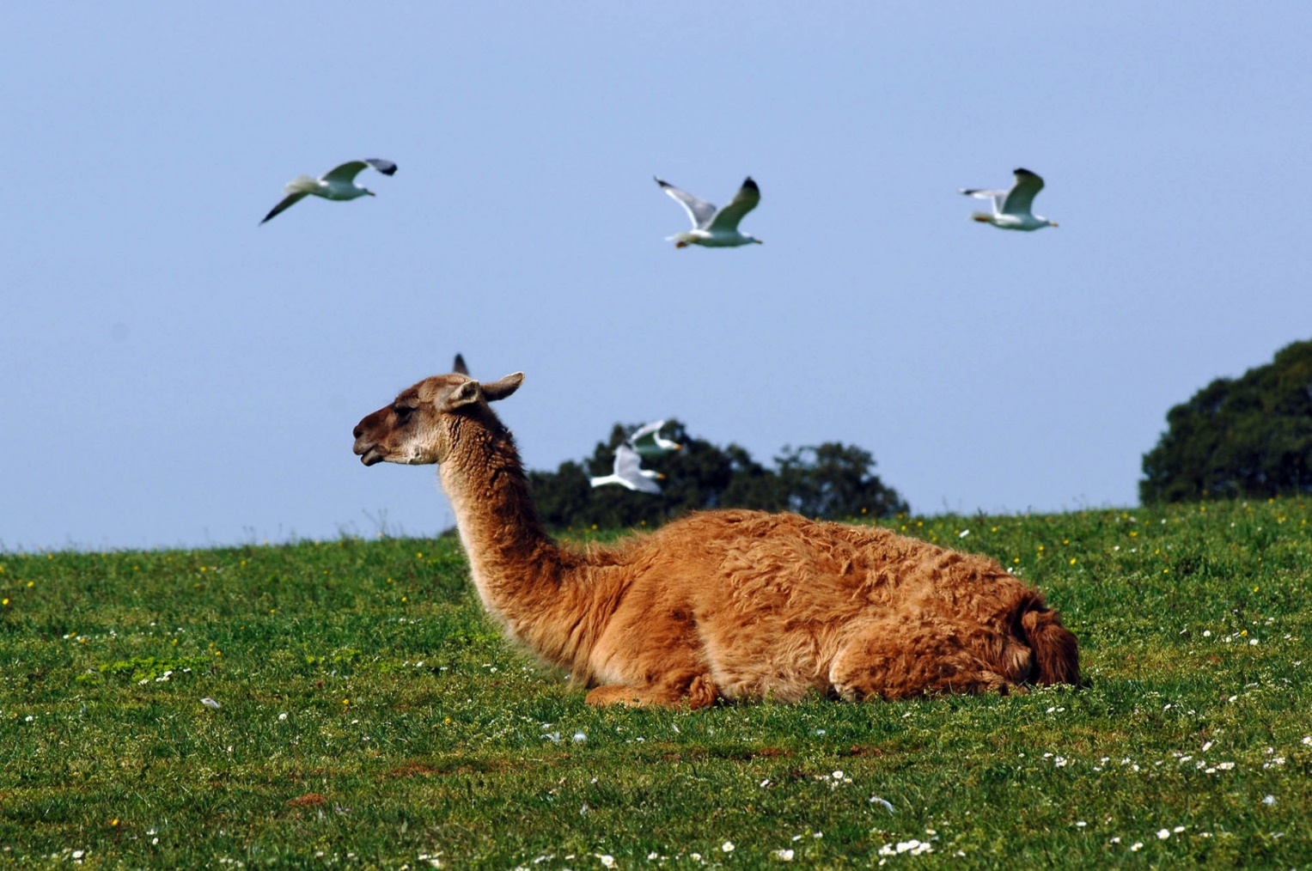
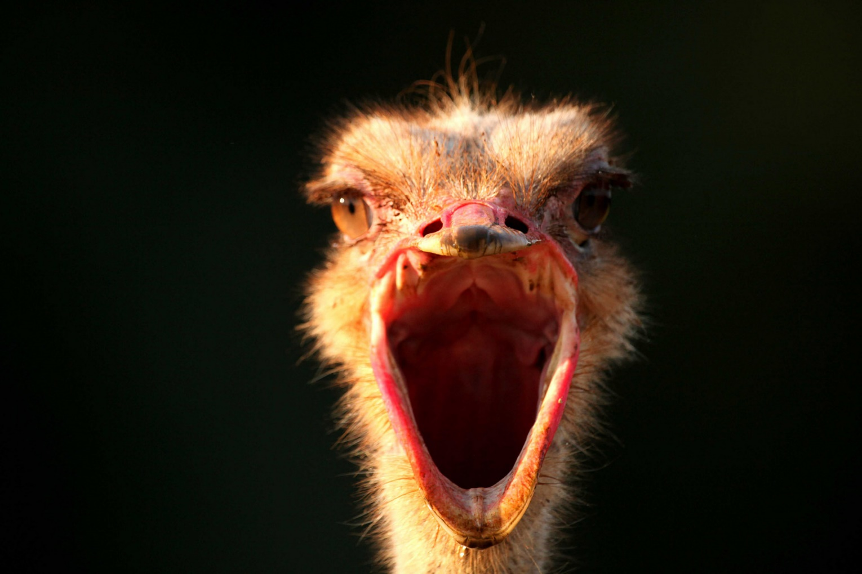
https://www.np-brijuni.hr/imagecache/maxsize/6f67e492-4a50-4136-93fd-89f06287a549/28-02-2019/img_3607.jpg
https://upload.wikimedia.org/wikipedia/commons/1/11/Bos_taurus_indicus.jpg
https://www.medias.rs/images/1/152/side-peacock.jpg
https://www.np-brijuni.hr/imagecache/maxsize/6f67e492-4a50-4136-93fd-89f06287a549/16-04-2019/brsa0201.jpg
https://www.np-brijuni.hr/imagecache/maxsize/6f67e492-4a50-4136-93fd-89f06287a549/28-02-2019/img_3456.jpg.jpg

Slide 10
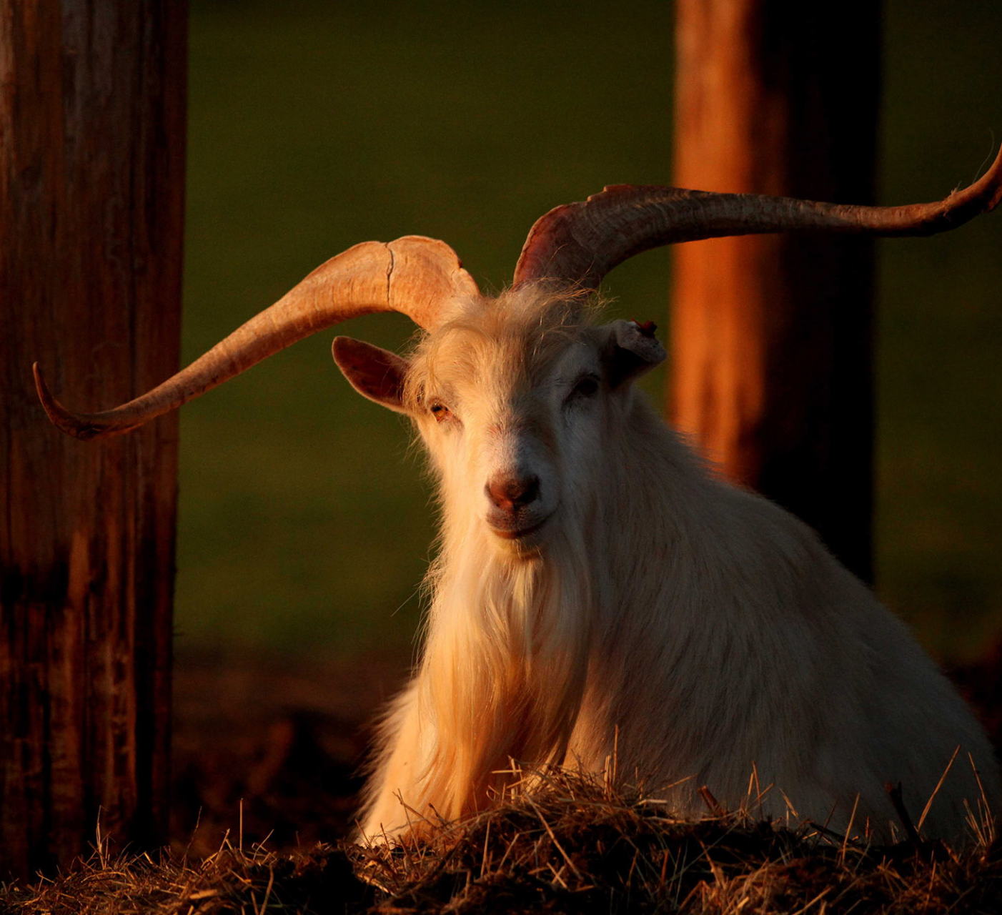
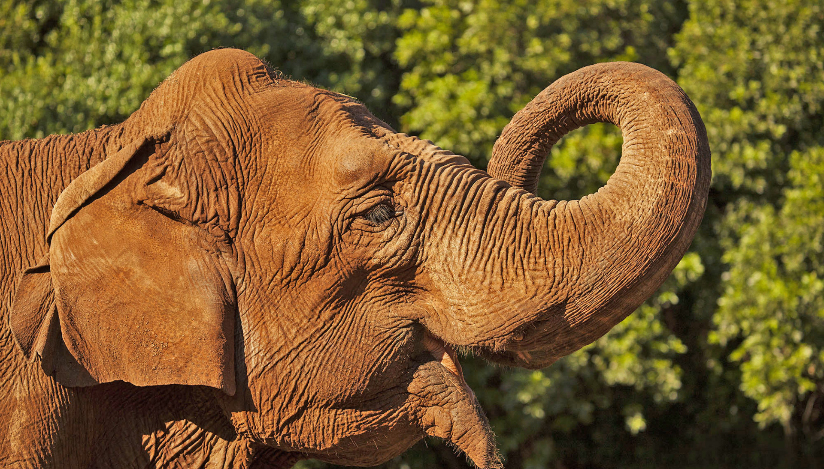
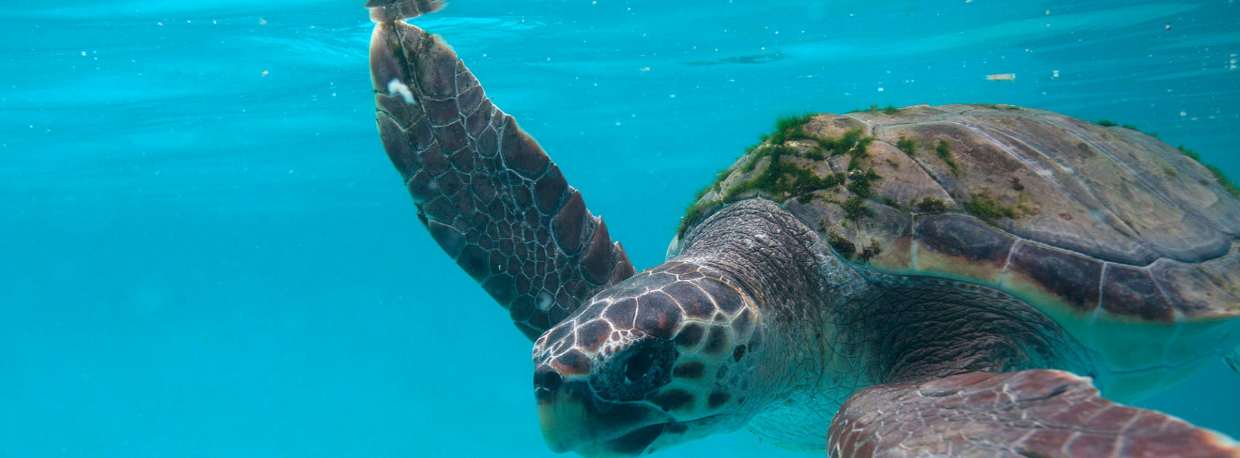
https://www.np-brijuni.hr/imagecache/maxsize/6f67e492-4a50-4136-93fd-89f06287a549/03-04-2019/slonica_lanka.jpg
https://www.np-brijuni.hr/imagecache/maxsize/6f67e492-4a50-4136-93fd-89f06287a549/28-02-2019/img_4109.jpg
https://www.np-brijuni.hr/imagecache/maxsize/6f67e492-4a50-4136-93fd-89f06287a549/08-03-2019/morske_kornjace_brijuni.jpg

Slide 11
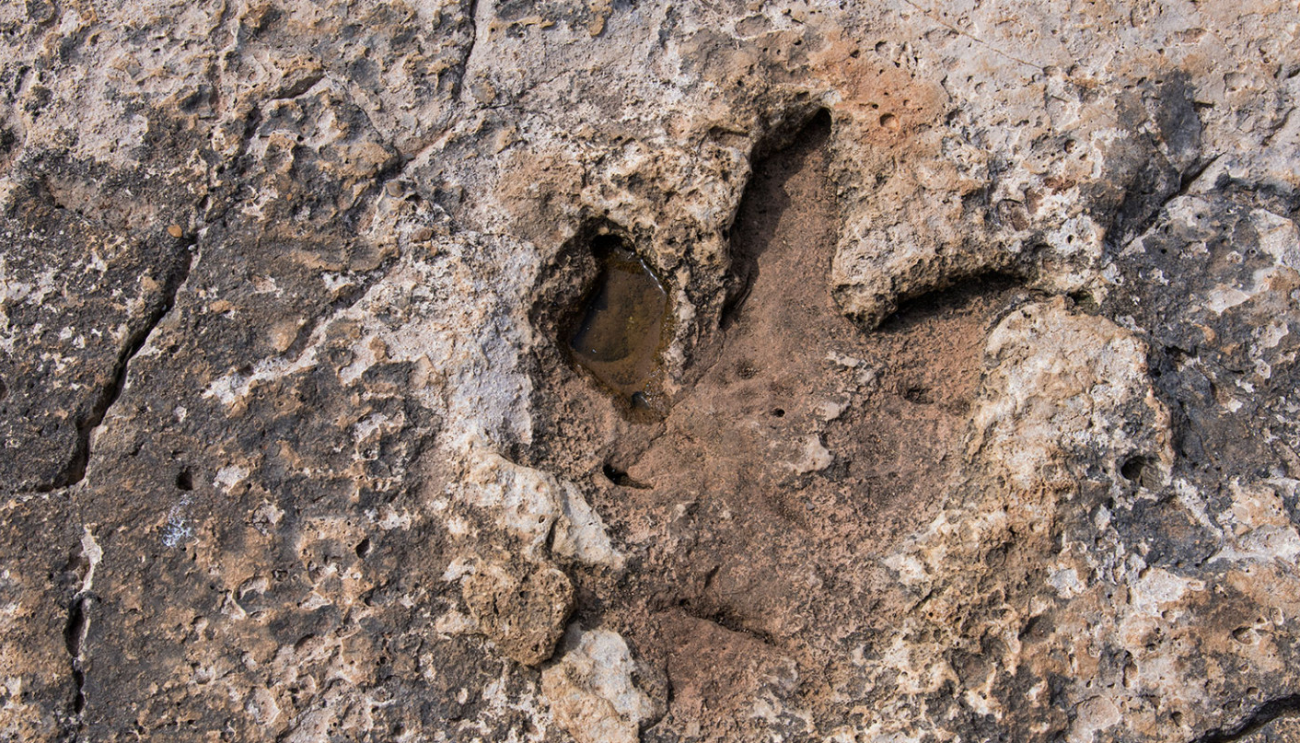
https://www.np-brijuni.hr/imagecache/maxsize/6f67e492-4a50-4136-93fd-89f06287a549/02-03-2019/stopa_dinosaura.jpg

Slide 12
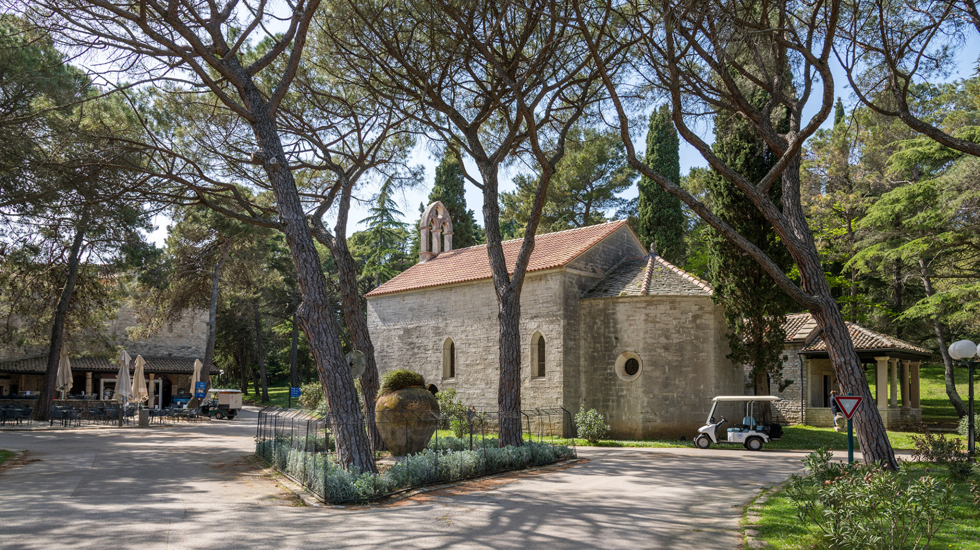
https://www.np-brijuni.hr/imagecache/maxsize/6f67e492-4a50-4136-93fd-89f06287a549/08-03-2019/crkva_sv_germana.jpg

Slide 13
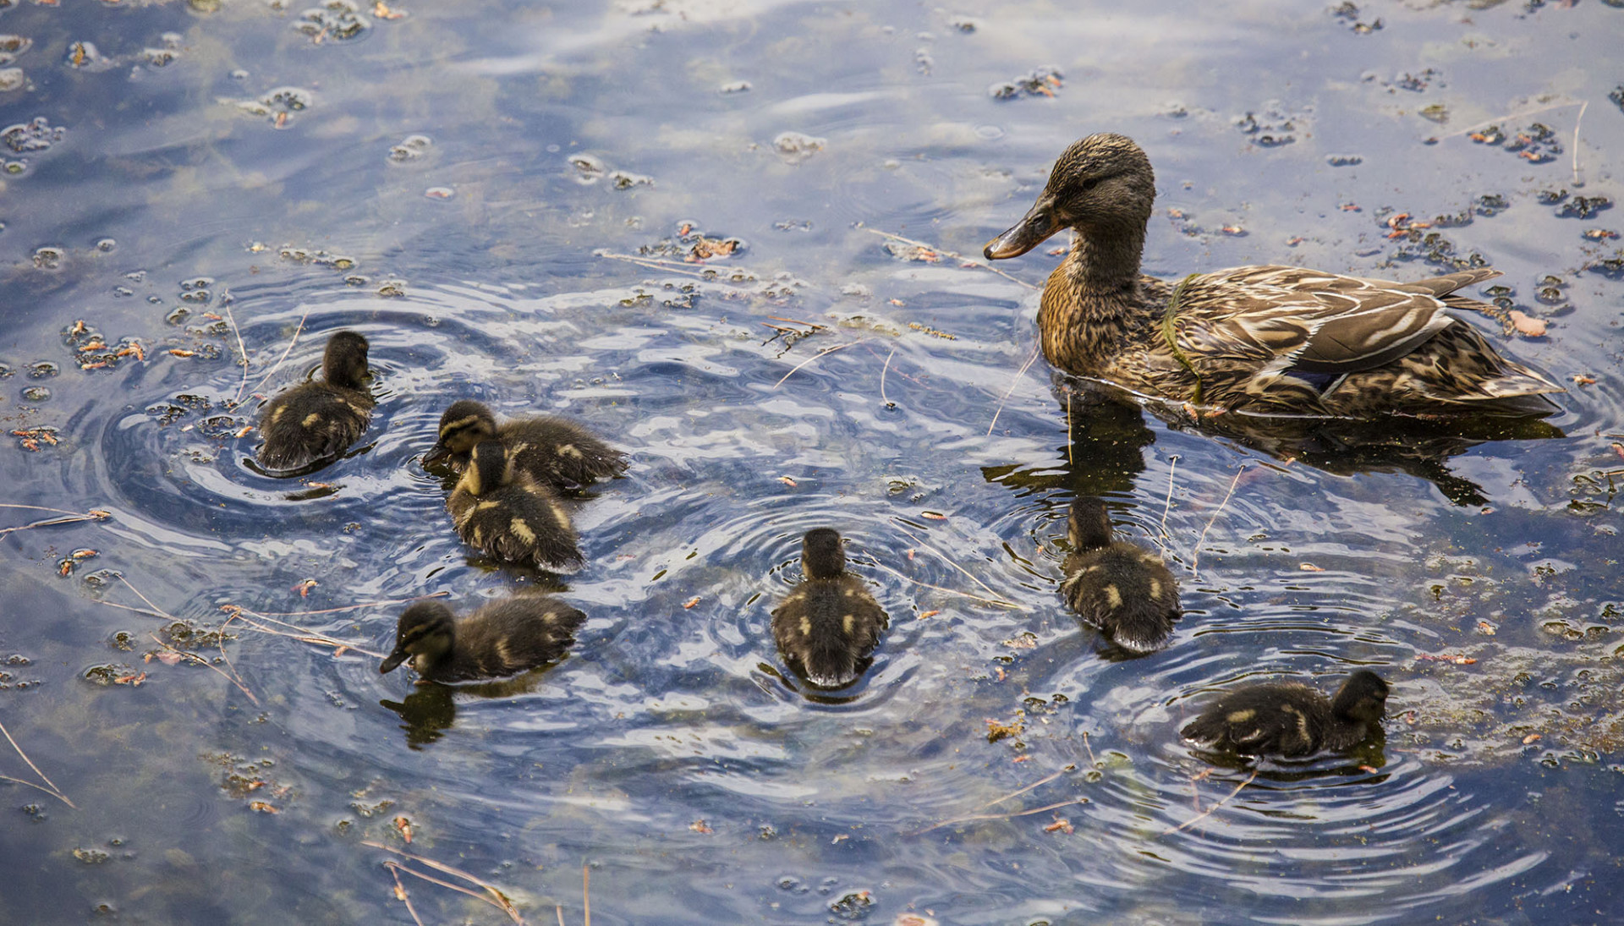
prirodna depresija
ptice
https://www.np-brijuni.hr/imagecache/maxsize/6f67e492-4a50-4136-93fd-89f06287a549/13-03-2019/bu8a5351.jpg

Slide 14
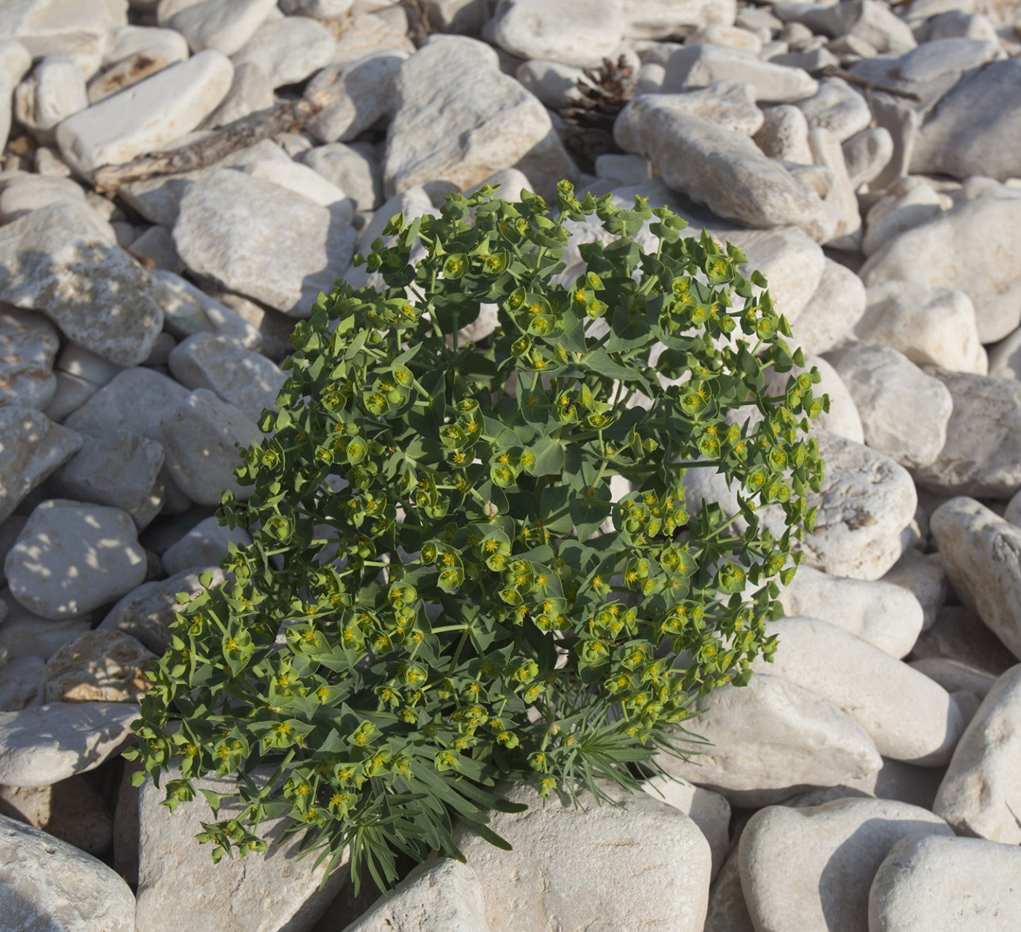
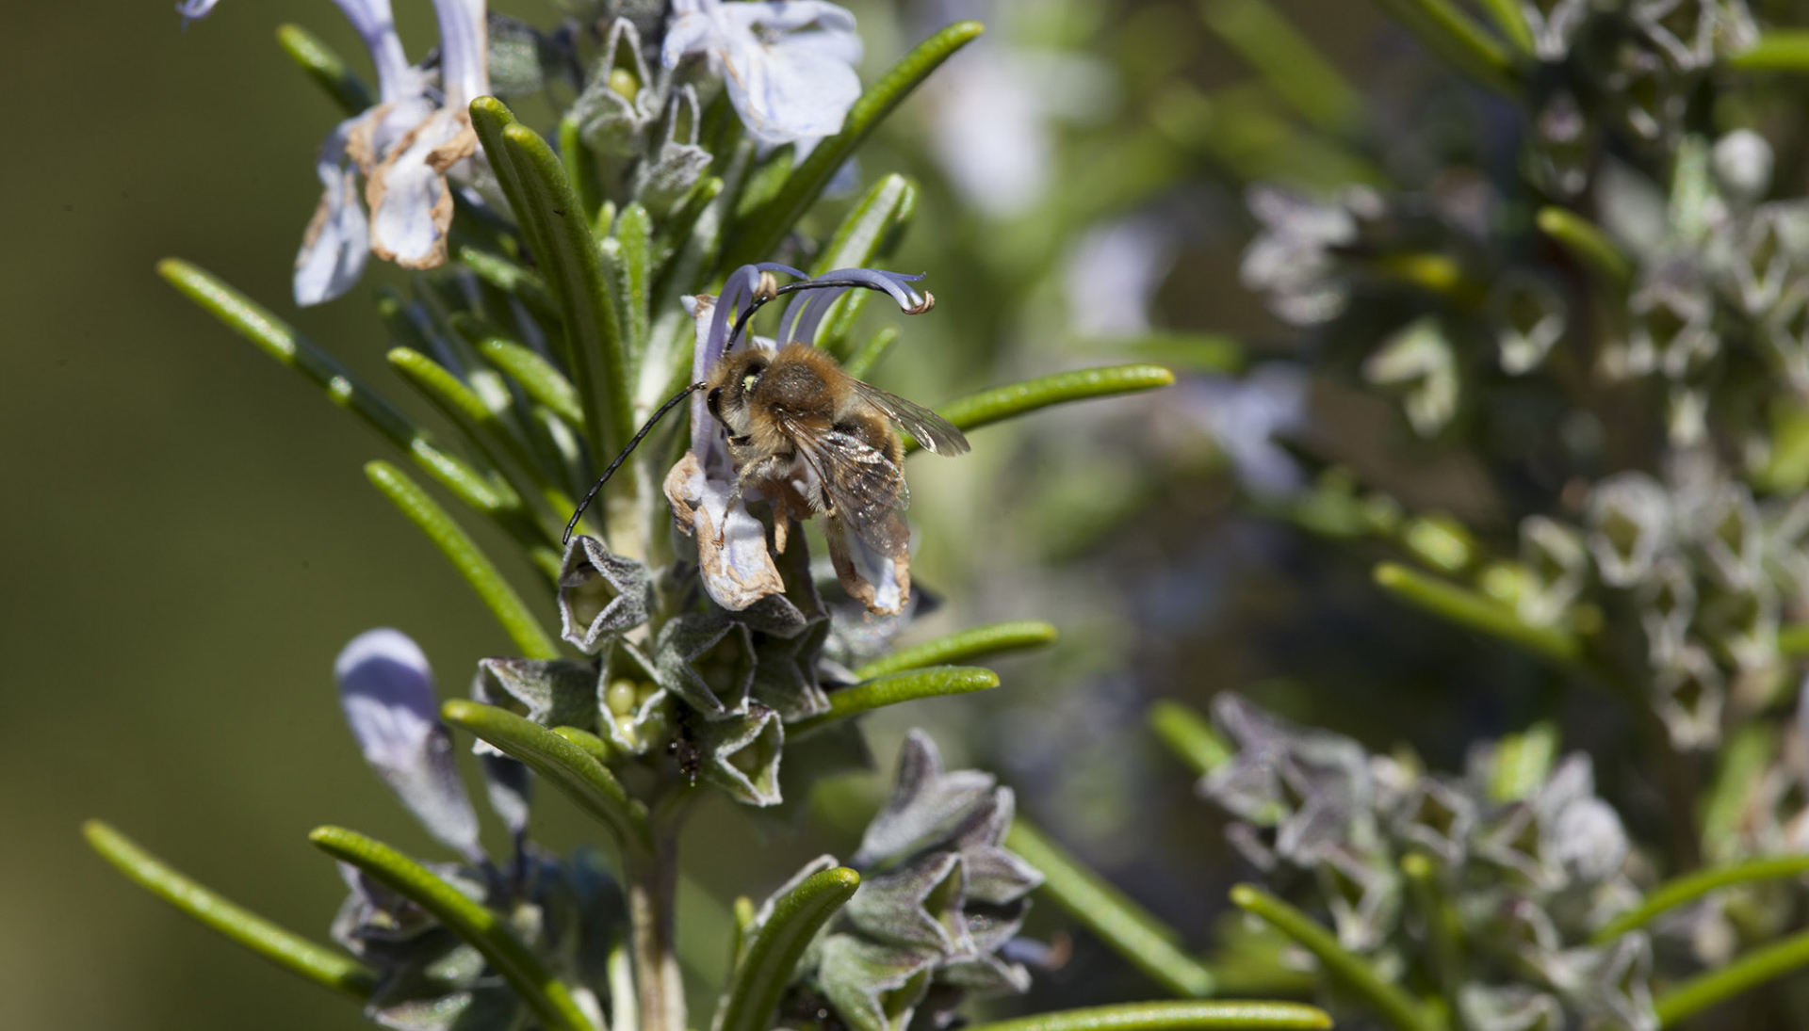
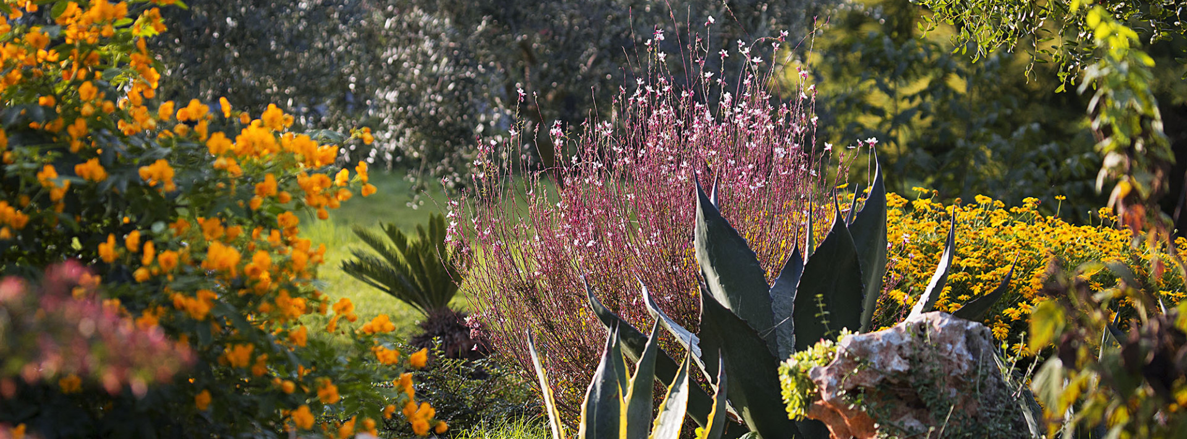
https://www.np-brijuni.hr/imagecache/maxsize/6f67e492-4a50-4136-93fd-89f06287a549/28-02-2019/brijuni_0518_mg_9288_2.jpg
https://www.np-brijuni.hr/imagecache/maxsize/6f67e492-4a50-4136-93fd-89f06287a549/28-02-2019/brijuni_0073_mg_9299.jpg
https://www.np-brijuni.hr/imagecache/maxsize/6f67e492-4a50-4136-93fd-89f06287a549/11-03-2019/mediteranski_vrt.jpg

Slide 15
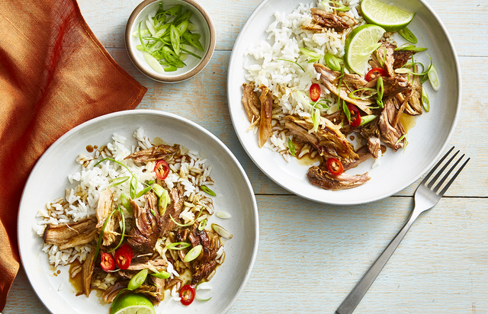
https://hips.hearstapps.com/hmg-prod.s3.amazonaws.com/images/healthy-recipes-marquee-1577978180.png?crop=0.663xw:0.993xh;0.171xw,0&resize=640:*

Slide 16
https://www.np-brijuni.hr/imagecache/maxsize/6f67e492-4a50-4136-93fd-89f06287a549/08-03-2019/zelenikovac1.jpg

Slide 17
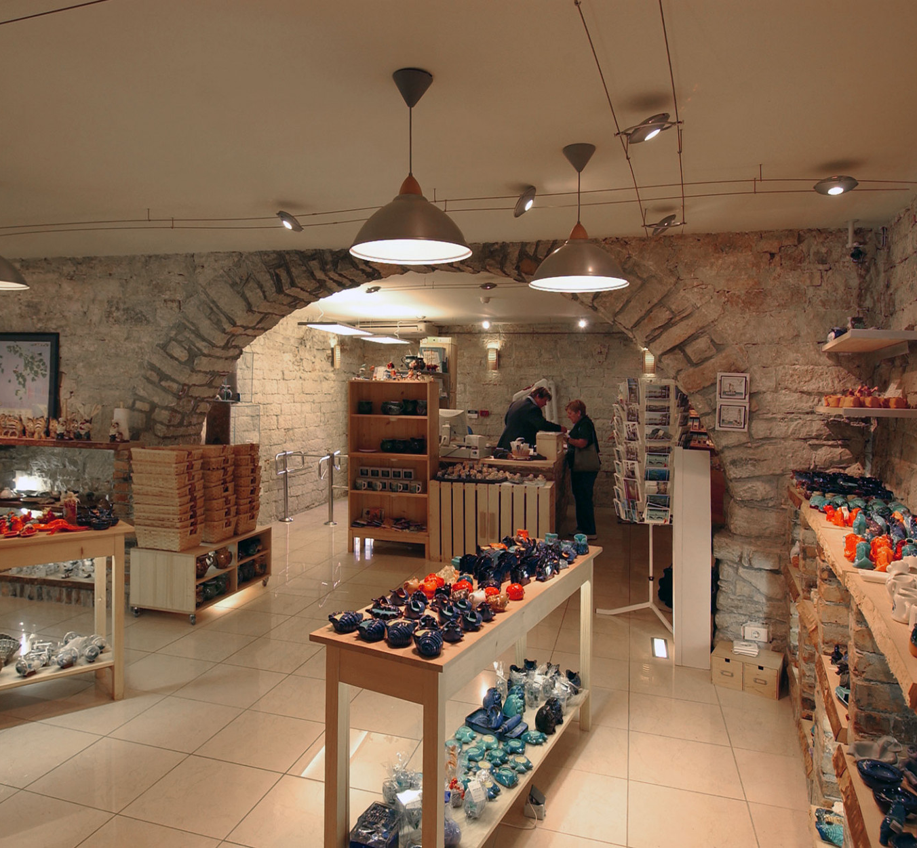
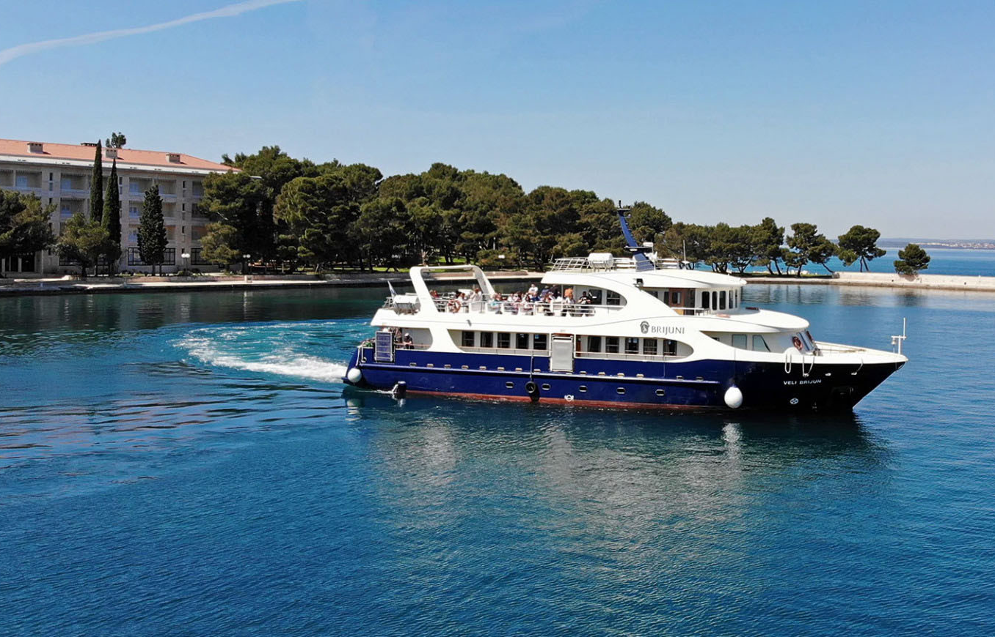
https://www.np-brijuni.hr/imagecache/maxsize/6f67e492-4a50-4136-93fd-89f06287a549/08-03-2019/suvenirnica.jpg
https://www.np-brijuni.hr/imagecache/maxsize/6f67e492-4a50-4136-93fd-89f06287a549/03-04-2019/plovidbeni_red2.jpg

Slide 18
Literatura
NP Brijuni. https://www.np-brijuni.hr/hr, pristupljeno 12.6.2020.
Separe. https://uslikaj.wordpress.com/2012/10/05/bijeli-albino-paun/, pristupljeno 12.6.2020.
https://www.np-brijuni.hr/imagecache/maxsize/6f67e492-4a50-4136-93fd-89f06287a549/28-02-2019/img_5445.jpg

Slide 19
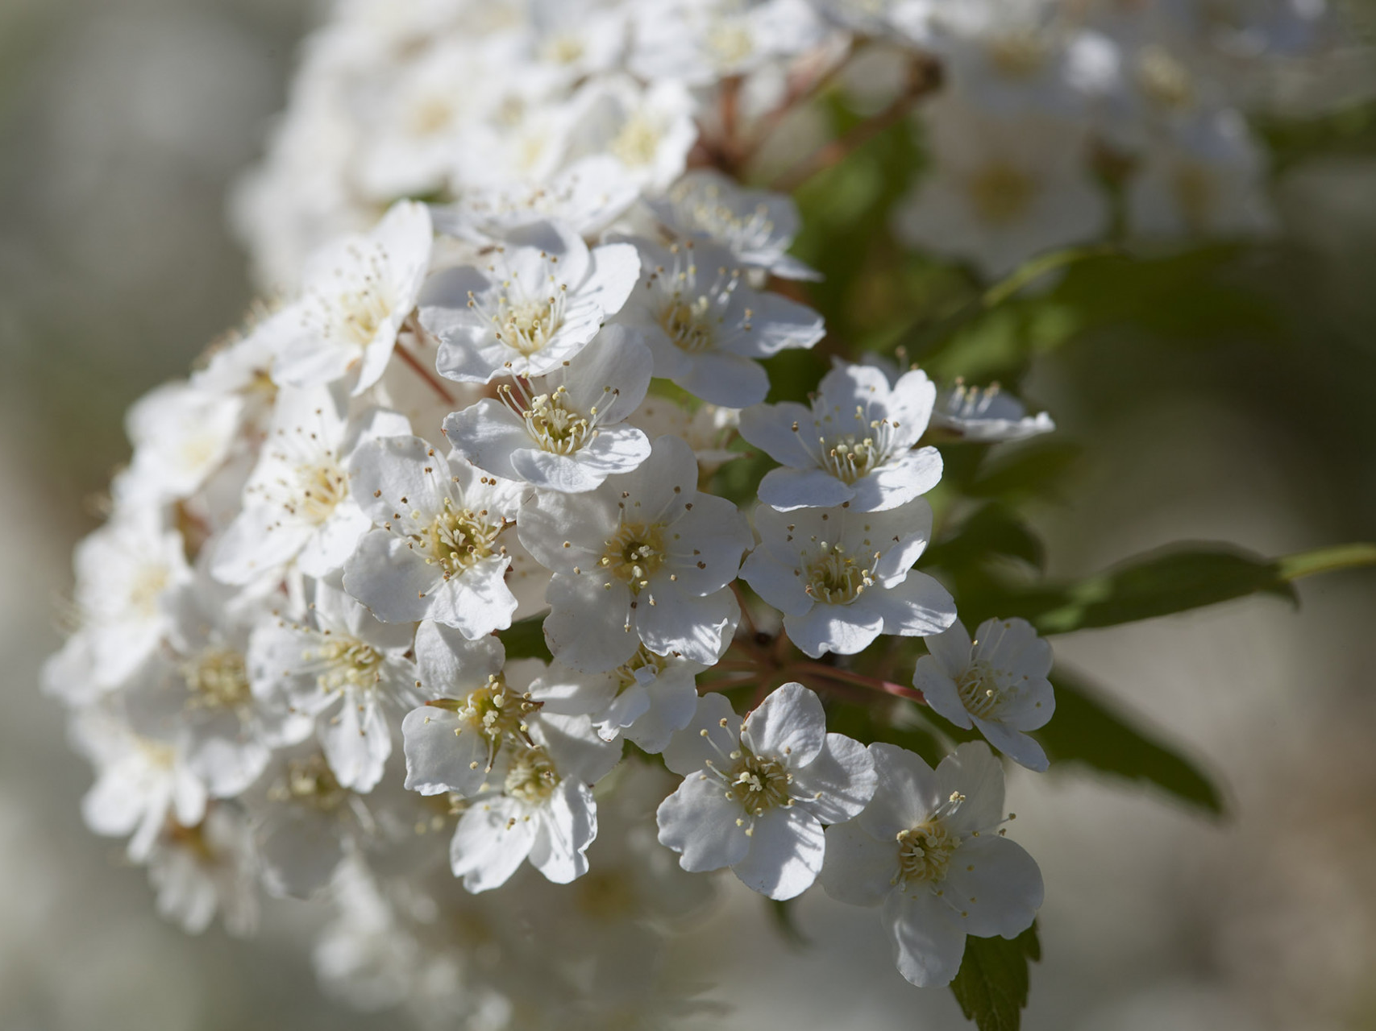
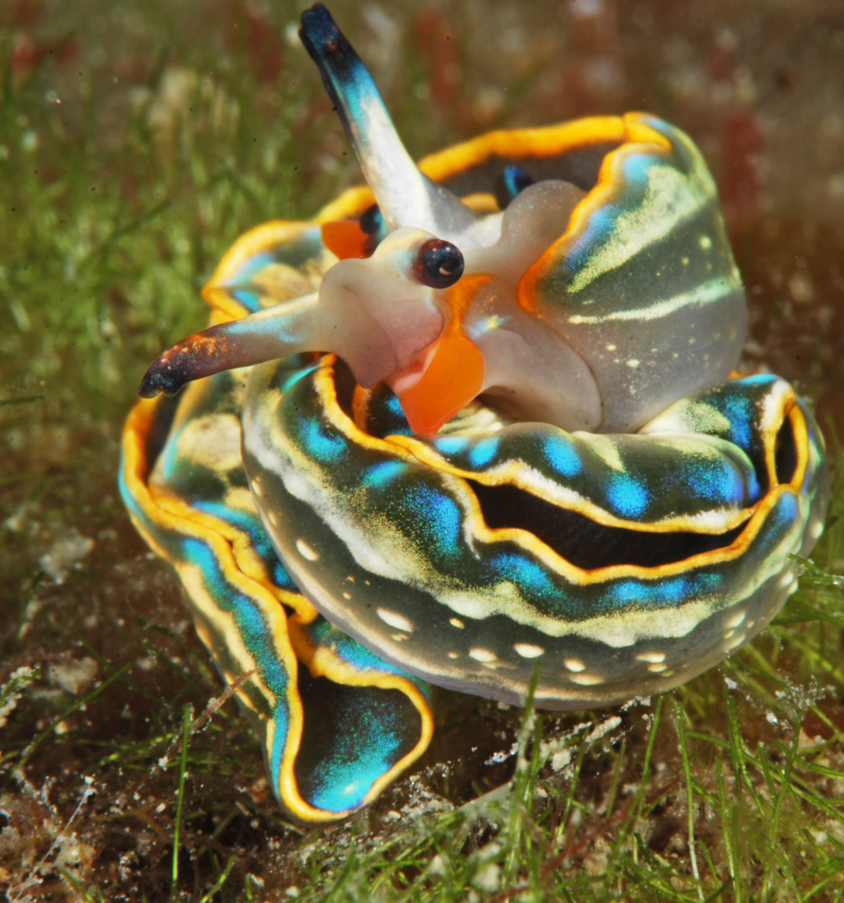
https://www.np-brijuni.hr/imagecache/maxsize/6f67e492-4a50-4136-93fd-89f06287a549/09-04-2019/morski_puz_marnio_brzac.jpg
https://www.np-brijuni.hr/imagecache/maxsize/6f67e492-4a50-4136-93fd-89f06287a549/28-02-2019/brijuni_0509_mg_9280.jpg

